Slide 1
Reinforcement Learning
M2 Keisuke Fukuta

Slide 2
Agendas
Overview of RL
Hands On

Slide 3
Comparison of sample efficiency

Slide 4
Comparison of sample efficiency

Slide 5
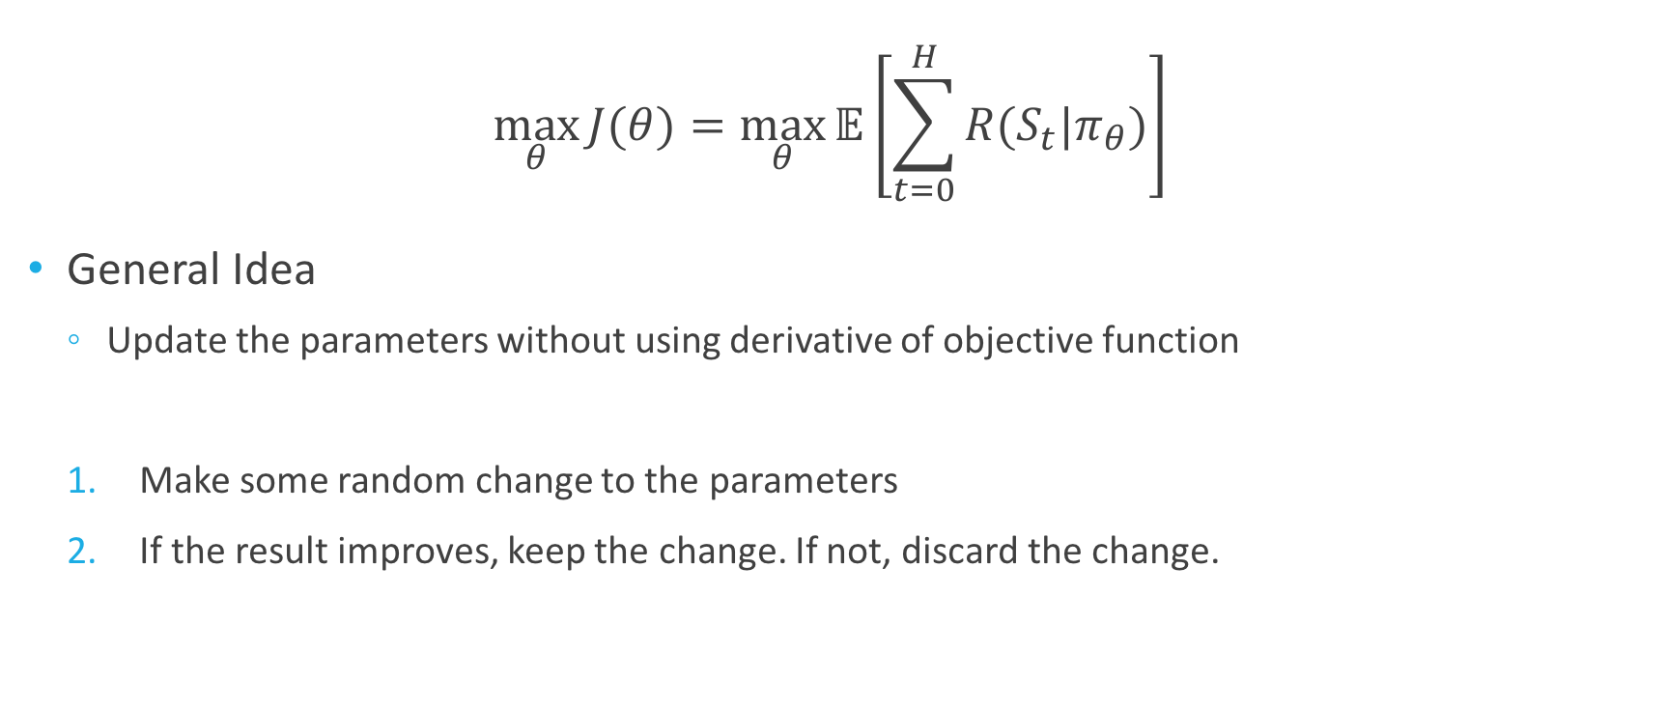
Gradient free methods (Evolutionary Methods)
$$\max_{θ}{J(θ)}=\max_{θ}{𝔼\left[\sum_{t=0}^{H}{R(S_{t}|π_{θ})}\right]}$$
General Idea
Update the parameters without using derivative of objective function
Make some random change to the parameters
If the result improves, keep the change. If not, discard the change.

Slide 6
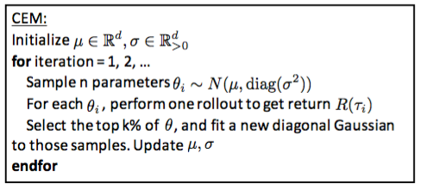
E.g. Cross Entropy Method

Slide 7
Comparison of sample efficiency

Slide 8
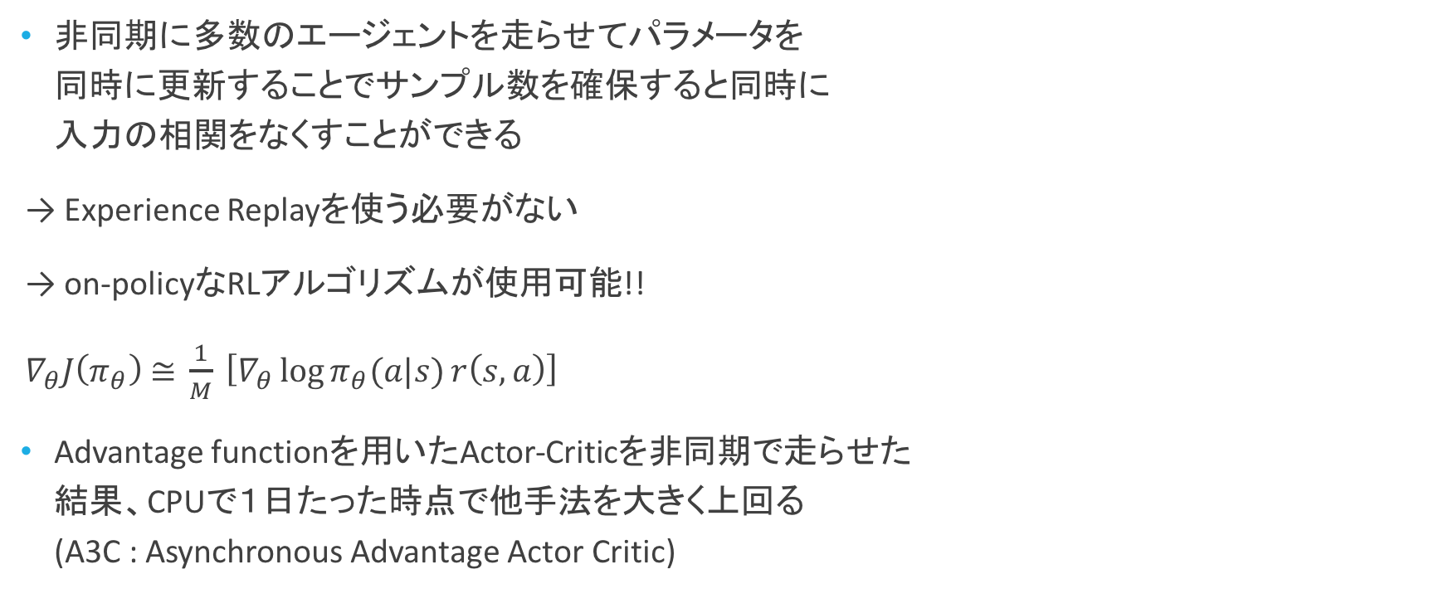
Asynchronous Methods for Deep Reinforcement Learning [Mnih et al., 2016]
非同期に多数のエージェントを走らせてパラメータを 同時に更新することでサンプル数を確保すると同時に 入力の相関をなくすことができる
→ Experience Replayを使う必要がない
→ on-policyなRLアルゴリズムが使用可能!!
$∇_{θ}J\left(π_{θ}\right) \text{≅} \frac{1}{M} \left[∇_{θ}\log{π_{θ}(a|s)}r\left(s, a\right)\right]$
Advantage functionを用いたActor-Criticを非同期で走らせた 結果、CPUで１日たった時点で他手法を大きく上回る (A3C : Asynchronous Advantage Actor Critic)

Slide 9
Comparison of sample efficiency

Slide 10
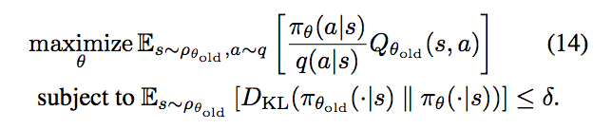
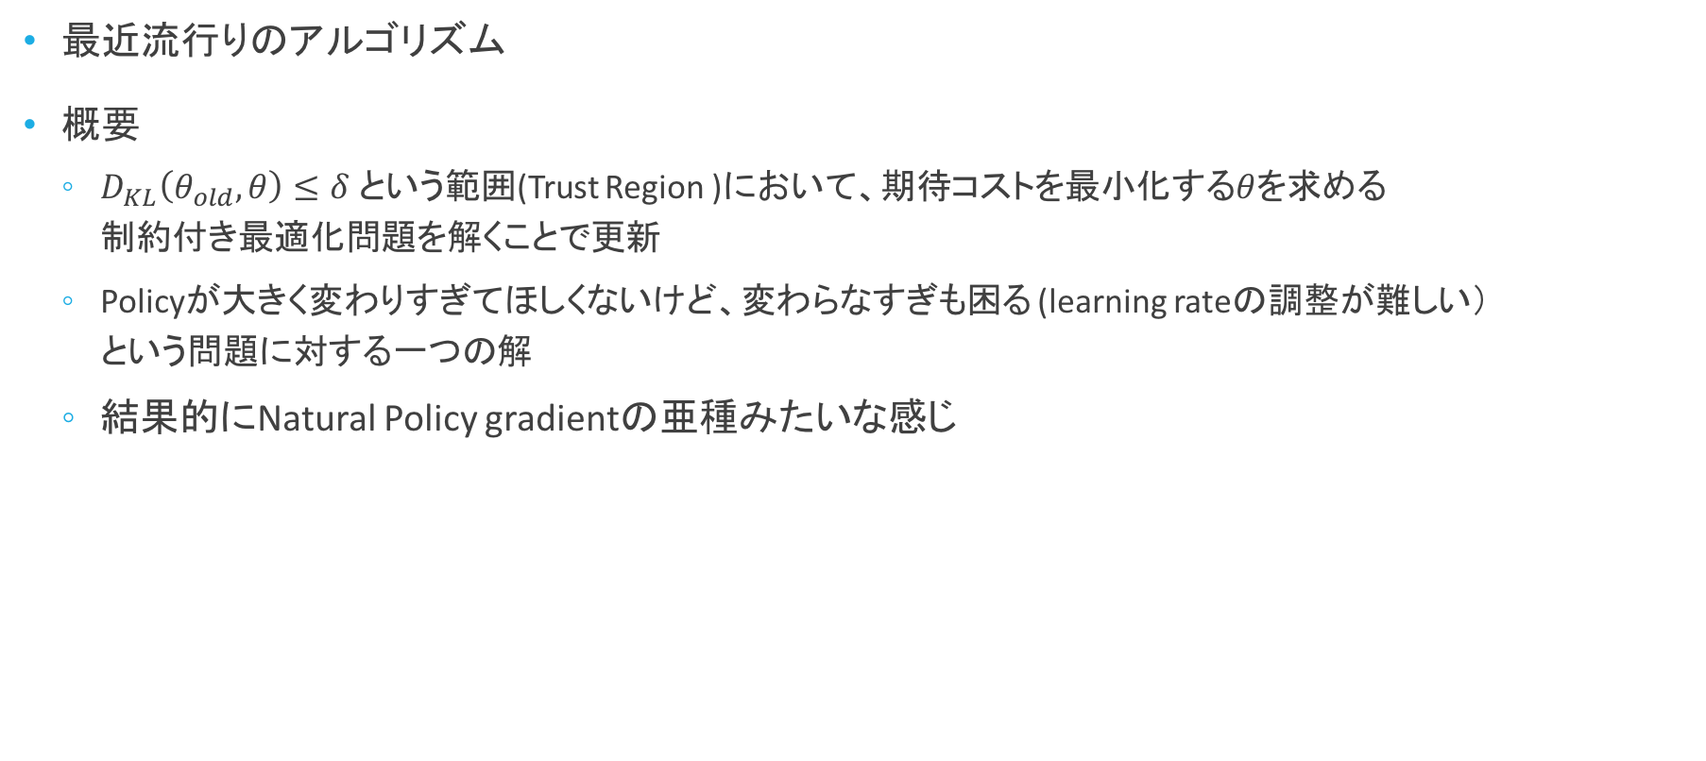
Trust Region Policy Optimization (TRPO)
最近流行りのアルゴリズム
概要
$D_{KL}\left(θ_{old}, θ\right)≤δ$ という範囲(Trust Region )において、期待コストを最小化する$θ$を求める 制約付き最適化問題を解くことで更新
Policyが大きく変わりすぎてほしくないけど、変わらなすぎも困る (learning rateの調整が難しい） という問題に対する一つの解
結果的にNatural Policy gradientの亜種みたいな感じ

Slide 11
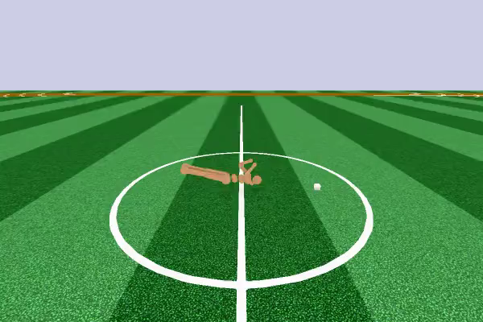
Trust Region Policy Optimization (TRPO)
動画

Slide 12
Comparison of sample efficiency

Slide 13
Comparison of sample efficiency

Slide 14
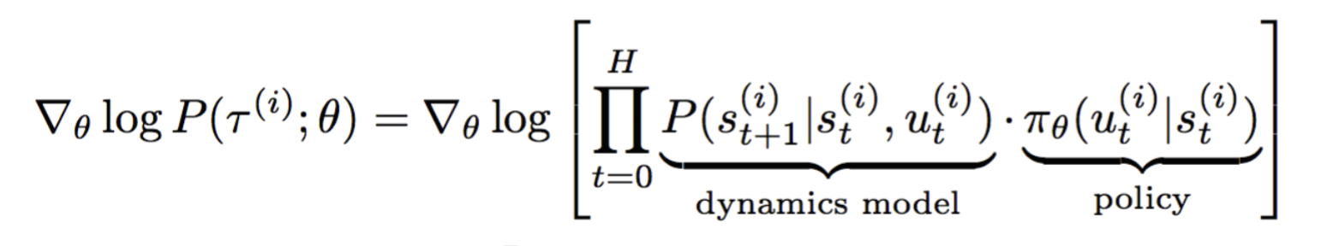

Model-based RL
So far….
Can we estimate transition function $P\left(s^{′} | s,a\right) ?????$
Unknown

Slide 15
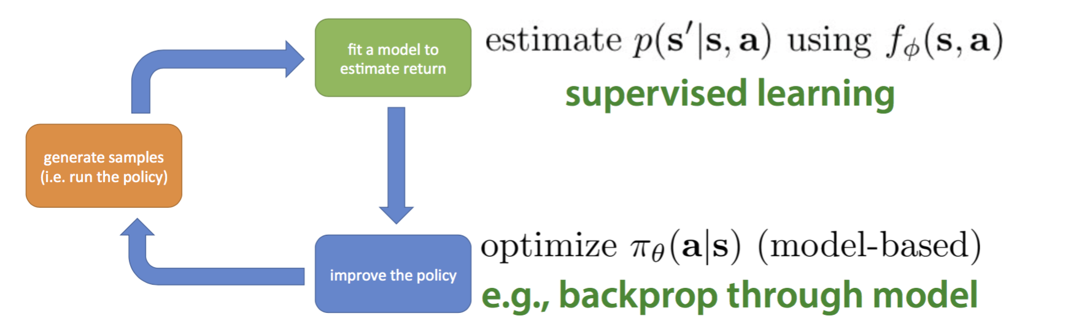
Model-based RL

Slide 16
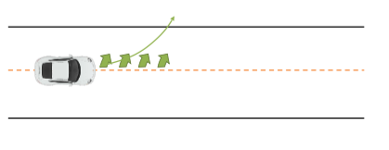
Model-based RL
Often fail to predict
How to avoid it???

Slide 17
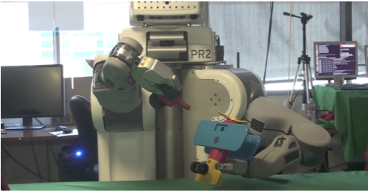
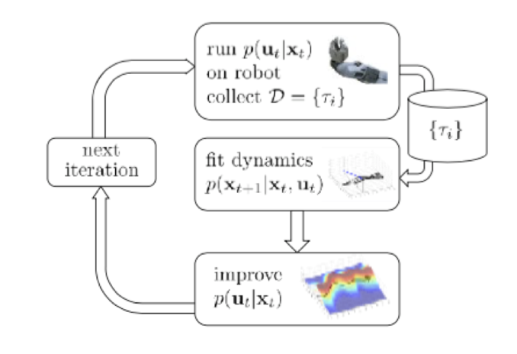
Guided Policy Search [Sergey Levine, 2015]
概要
UC Berkeleyのチーム
実機ロボットでpolicyの学習
手法概要
近傍のダイナミクスを線形近似し、 ローカルに最適解を解析的に現代制御で解く。
Neural networkにそれぞれのローカルの解を転写

Slide 18
Guided Policy Search [Sergey Levine, 2015]
https://www.youtube.com/watch?v=JeVppkoloXs

Slide 19
Comparison of sample efficiency

Slide 21

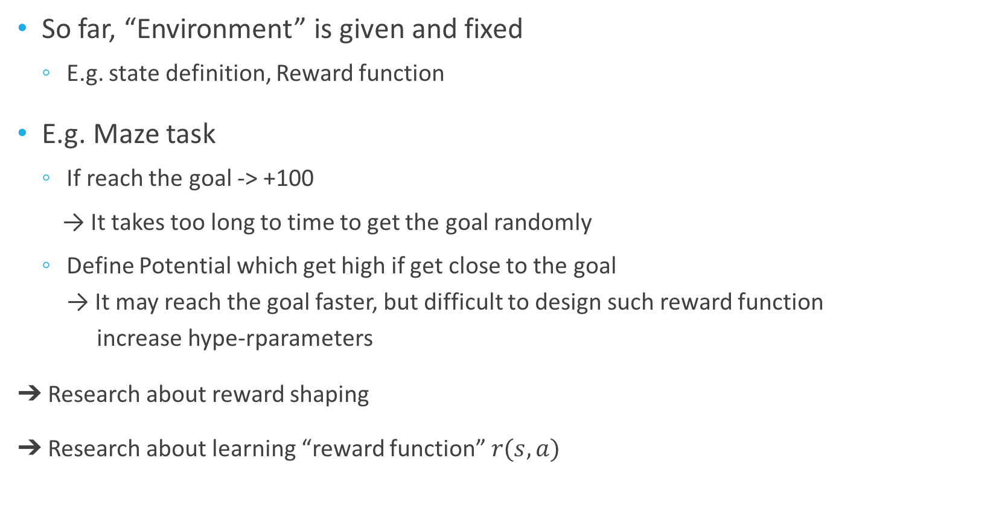
Design of Reward
So far, “Environment” is given and fixed
E.g. state definition, Reward function
E.g. Maze task
If reach the goal -> +100
→ It takes too long to time to get the goal randomly
Define Potential which get high if get close to the goal → It may reach the goal faster, but difficult to design such reward function increase hype-rparameters
➔ Research about reward shaping
➔ Research about learning “reward function” $r(s, a)$

Slide 22
Inverse Reinforcement Learning
In RL, reward or what is good -> optimal policy
In IRL, optimal policy (human demonstration) -> reward function
Reward
RL
Optimal Policy
IRL

Slide 23
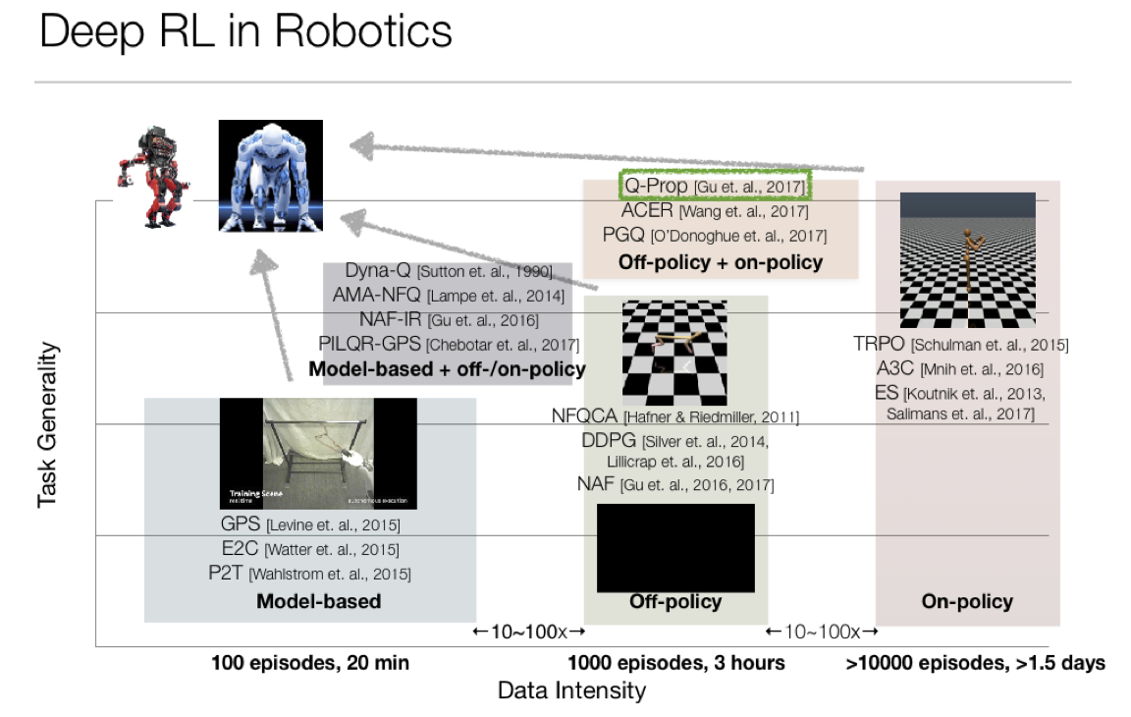

Slide 24
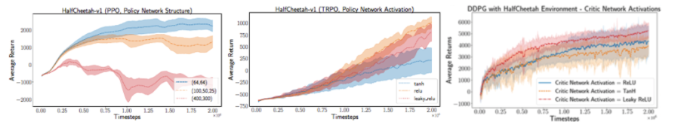
Darkness of RL
RL is verrry sensitive to hyper parameters (even to seed)
↓ Different results from different activation function

Slide 25
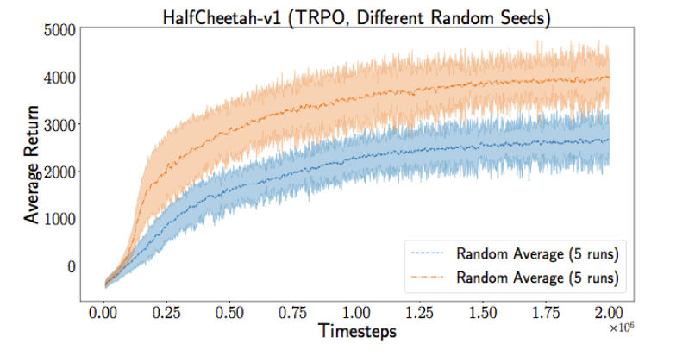
Darkness of RL
Different results from different seeds

Slide 26
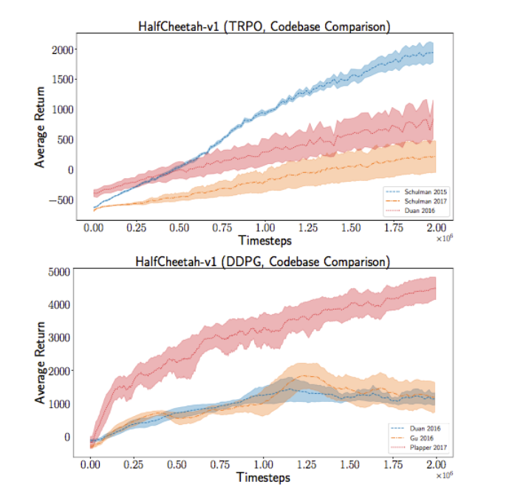
Darkness of RL
Different results from different implementations

Slide 27
Summary
RL is verrrry broad notion
Model-based or model-free
Value-based or Policy-based or Both
Off-policy or On-policy
Recently, “Deep Reinforcement Learning” has been active domain of research
Interpret rich sensory inputs (DL)
Choose complex actions (RL)
However, sample efficiency and robustness are still big problem

Slide 28
Reference
David silverの講義資料
http://www0.cs.ucl.ac.uk/staff/d.silver/web/Teaching_files/intro_RL.pdf
Policy search資料
http://icml.cc/2015/tutorials//PolicySearch.pdf
DeepRLBootcamp資料
https://sites.google.com/view/deep-rl-bootcamp/labs
https://sites.google.com/view/deep-rl-bootcamp/lectures

Slide 29
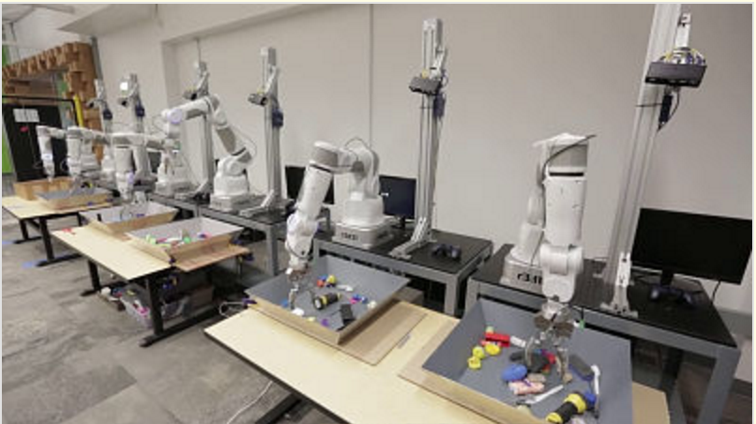
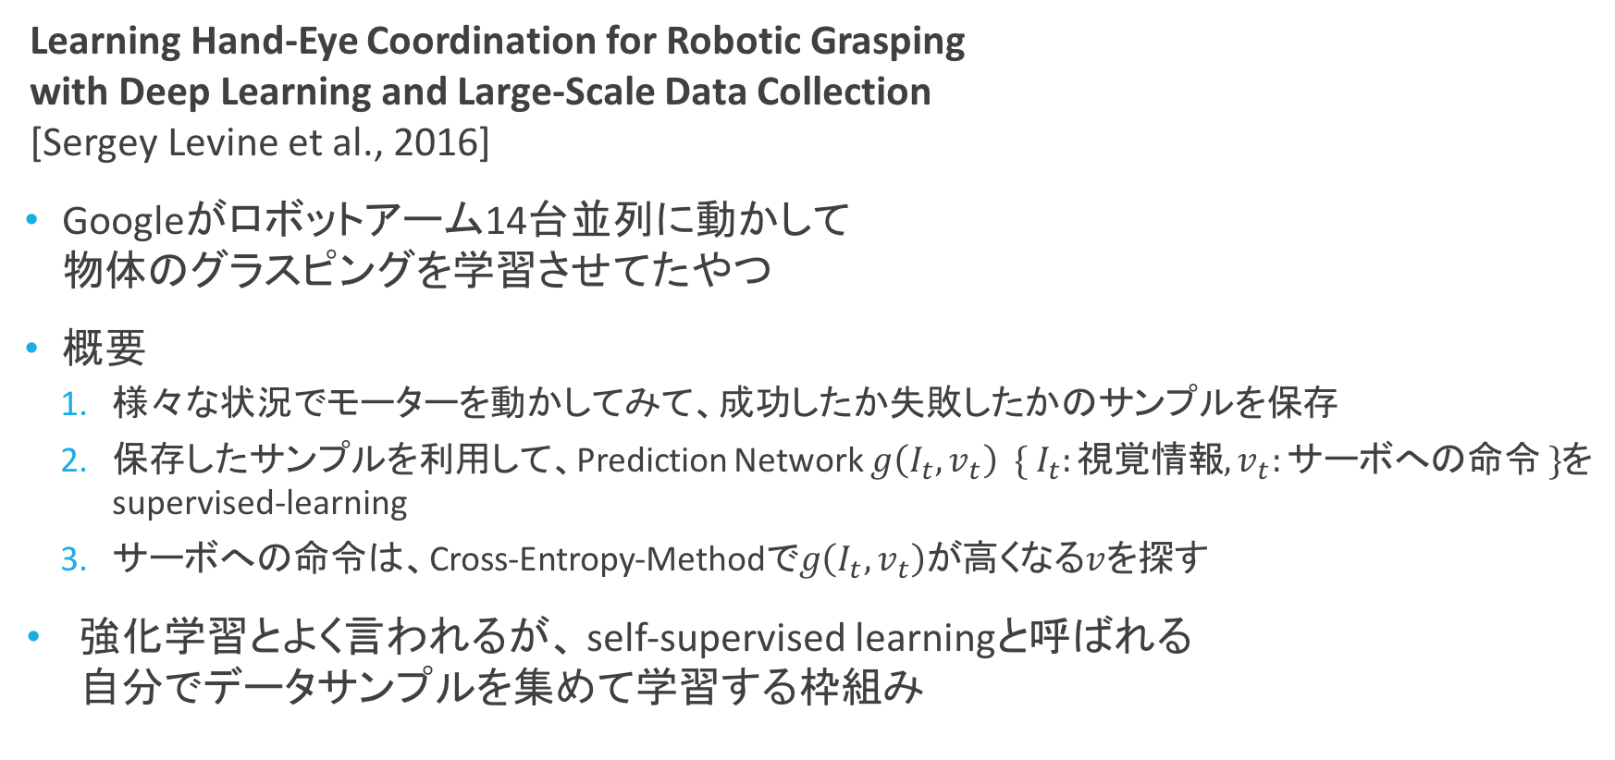
おまけ
Learning Hand-Eye Coordination for Robotic Grasping with Deep Learning and Large-Scale Data Collection [Sergey Levine et al., 2016]
Googleがロボットアーム14台並列に動かして 物体のグラスピングを学習させてたやつ
概要
様々な状況でモーターを動かしてみて、成功したか失敗したかのサンプルを保存
保存したサンプルを利用して、Prediction Network $g\left(I_{t}, v_{t}\right) \{ I_{t}:視覚情報, v_{t}:サーボへの命令 \}$を supervised-learning
サーボへの命令は、Cross-Entropy-Methodで$g\left(I_{t}, v_{t}\right)$が高くなる$v$を探す
強化学習とよく言われるが、 self-supervised learningと呼ばれる 自分でデータサンプルを集めて学習する枠組み

Slide 30
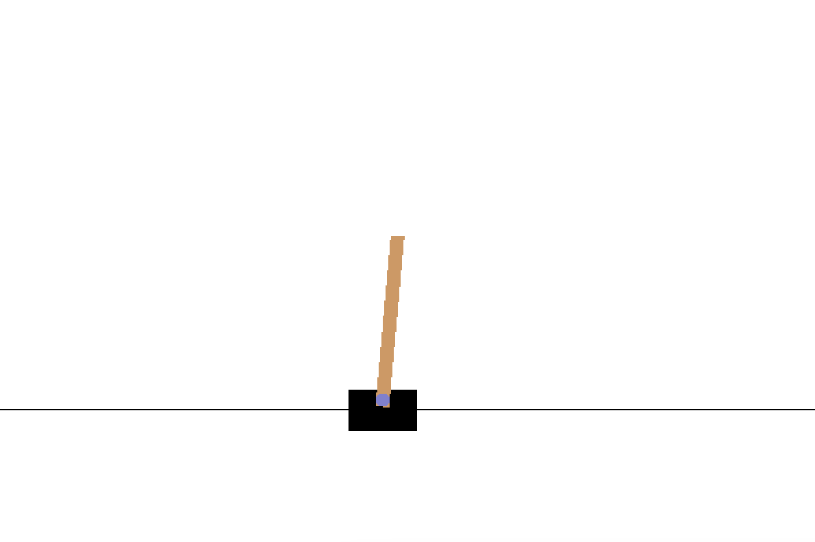
Hands On
We use “labs_final/” we provided last week
We will focus on lab4 section 3. “Policy gradient” (mainly 3.6~)
Learn card-pole agent with policy gradient!!!
We use
“labs_final/lab4/simplepg/main.py”
lab4.pdf (for material)
*Today we don’t use jupyter notebook

Slide 31
Hands On
Lab4.pdf Section 3
3.1 : background
3.2 : implementation for Point-v0 (optional)
3.3 : implementation update function for Point-v0 (optional)
3.4 : implementation baseline (optional)
3.5 : implementation another baseline (optional)
3.6 : implementation for CartPole-v0
3.7 : implementation natural gradient

Slide 32
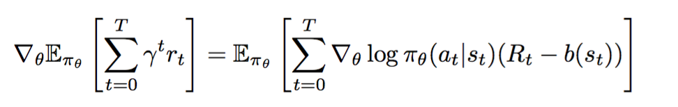
Hands On
Step1:
Read 3.1 Background
understand policy gradient
Step2:
Read 3.6
Implement cartpole_get_grad_logp_action() (main.py L94)
Implement compute_update() (main.py L223)
Run command $ ./docker_run.sh simplepg/main.py CartPole-v0 --use-baseline False --render True
Important!!!

Slide 33
Optional
Step3: Read 3.2~3.4 and implement compute_baselines()
$ ./docker_run.sh simplepg/main.py CartPole-v0 --render True
Step4: Read 3.7 and implement natural gradient
$ ./docker_run.sh simplepg/main.py CartPole-v0 --natural True --render True
* These answers are written in lab5

Slide 34
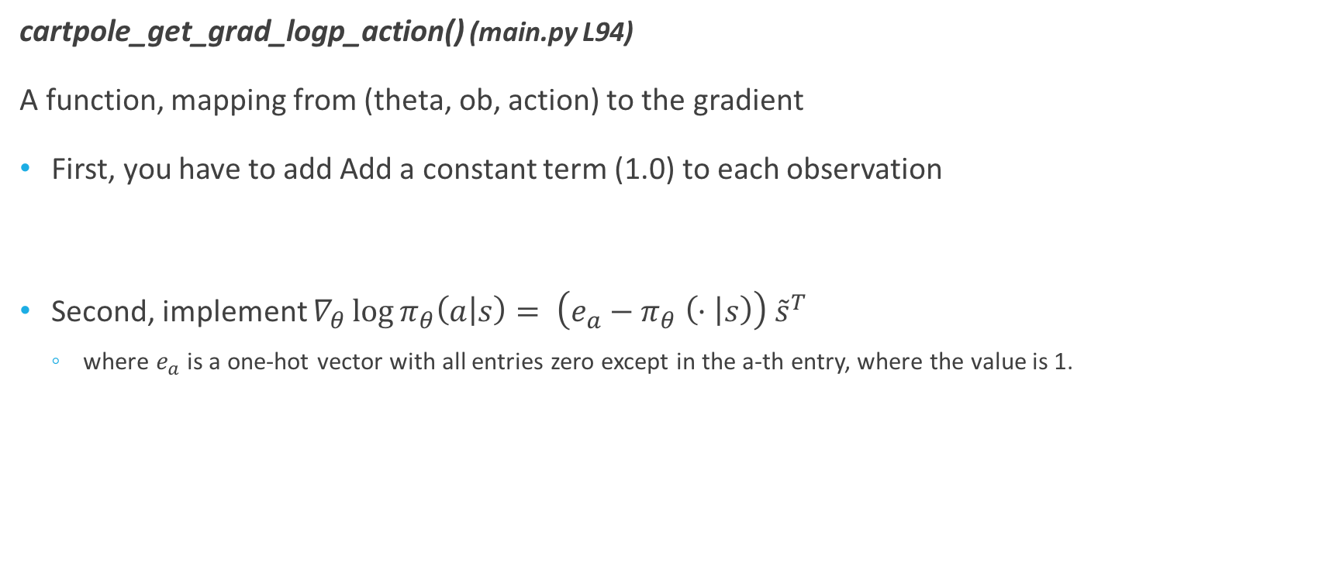
Hint
cartpole_get_grad_logp_action() (main.py L94)
A function, mapping from (theta, ob, action) to the gradient
First, you have to add Add a constant term (1.0) to each observation
Second, implement $∇_{θ}\log{π_{θ}\left(a | s\right)}= \left(e_{a}−π_{θ} \left(· | s\right)\right) {\tilde{s}}^{T}$
where $e_{a}$ is a one-hot vector with all entries zero except in the a-th entry, where the value is 1.

Slide 35
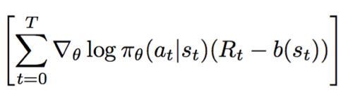
Hint
compute_update() (main.py L223)
Function calculate policy gradient
First, calculate R_t from (R_tplus1, r_t)
Second, multiply score function and advantage

Slide 36
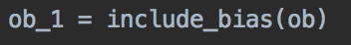
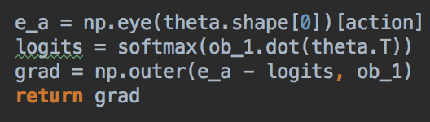
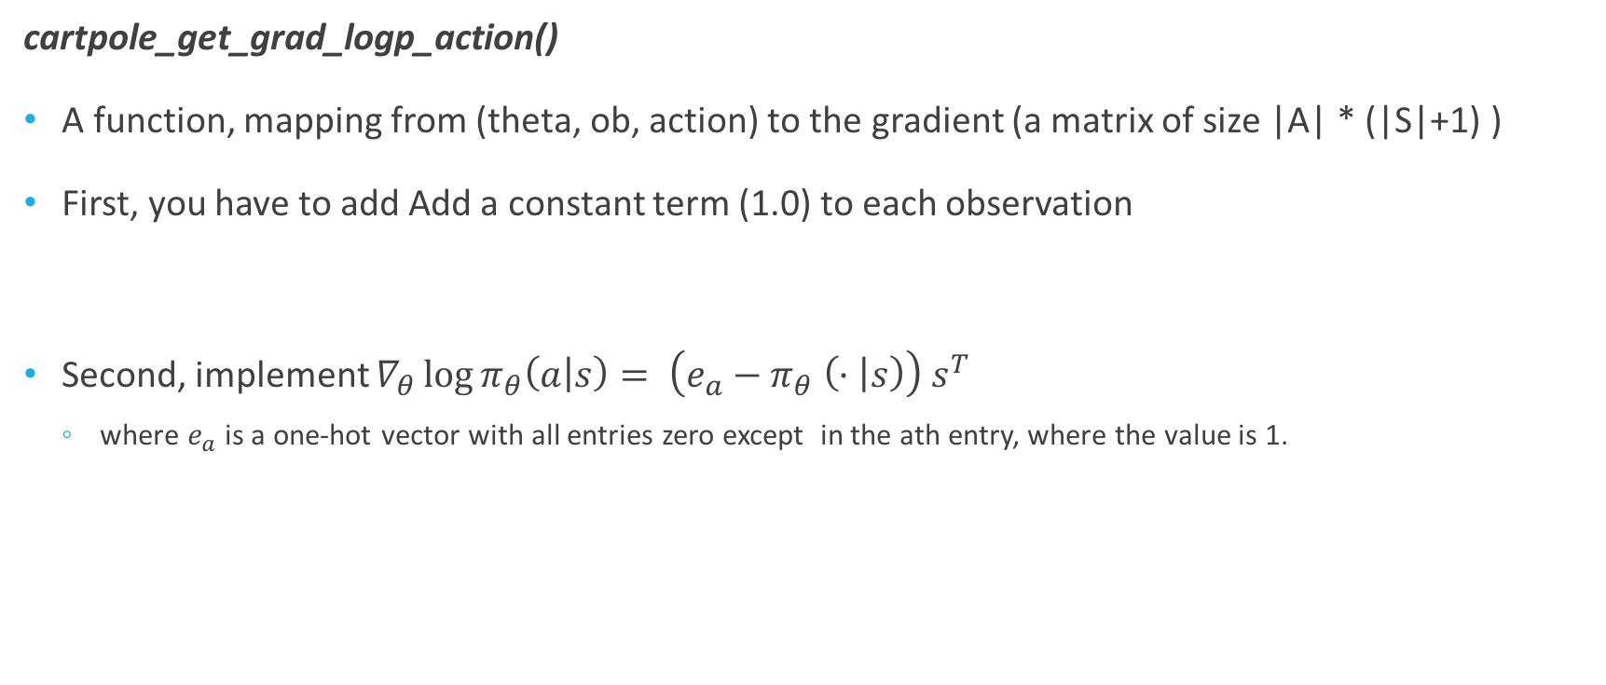
Hint
cartpole_get_grad_logp_action()
A function, mapping from (theta, ob, action) to the gradient (a matrix of size |A| * (|S|+1) )
First, you have to add Add a constant term (1.0) to each observation
Second, implement $∇_{θ}\log{π_{θ}\left(a | s\right)}= \left(e_{a}−π_{θ} \left(· | s\right)\right) s^{T}$
where $e_{a}$ is a one-hot vector with all entries zero except in the ath entry, where the value is 1.

Slide 37
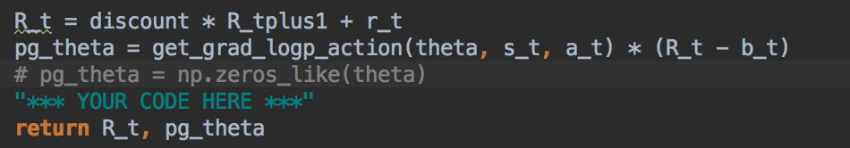
Hint
compute_update() (main.py L223)
Function calculate policy gradient
First, calculate R_t from (R_tplus1, r_t)
Second, multiply score function and advantage

